Slide 1

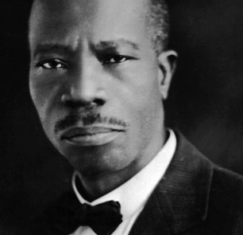
Fifth Illinois Jurisdiction - West
Charles Harrison Mason Bible College
Spring 2026 Session - Online Classes
March 12, 2026 – May 21, 2026
Register online and learn more about the
Word of God and enhance your skills
to be an asset to your local church ministry.
Pre-Register now at www.calvarytempleoutreachcogic.org
C. H. Mason Institute
Fall Orientation via Tele-Conference:
Thursday March 12, 2026, 5 - 7 PM
Dial - 1-508-924-2478
For additional information
Call: 773-785-0667 or 708-369-8943
Dr. Lillie M. English, Dean
Bishop Robert L. Perry, Jurisdictional Bishop
Mother Cleolia Wells-Penix, Jurisdictional Supervisor
Dr. Barbara Campbell & Dea. Derrick Hearns, Registrars

