Slide 1

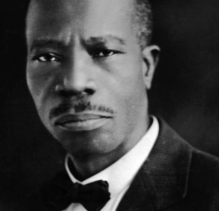
Fifth Illinois Jurisdiction - West
Charles Harrison Mason Bible College
Fall 2025 Session - Online Classes
September 11, 2025 – November 20, 2025
Register online and learn more about the
Word of God and enhance your skills
to be an asset to your local church ministry.
Pre-Register now at www.calvarytempleoutreachcogic.org
C. H. Mason Institute
Fall Orientation via Tele-Conference:
Thursday September 11, 2025, 5 - 7 PM
Dial - 1-508-924-2478
For additional information
call 1-773-239-3400 or 1-815-650-1471
Dr. Lillie M. English, Dean
Bishop Robert L. Perry, Jurisdictional Bishop
Mother Cleolia Wells-Penix, Jurisdictional Supervisor
Barbara Campbell & Derrick Hearns, Registrar

