Slide 1
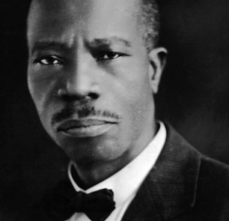
Fifth Illinois Jurisdiction - West
Charles Harrison Mason Bible College
Spring 2025 Session - Online Classes
March 13, 2025 – May 22, 2025
Register online and learn more about the
Word of God and enhance your skills
to be an asset to your local church ministry.
Pre-Register now at www.calvarytempleoutreachcogic.org
CH Mason Institute
Spring Orientation via Tele-Conference:
Thursday March 13, 2025, 5 - 7 PM
Dial - 1-508-924-2478
For additional information
call 1-708-369-8943 or 1-773-785-0667
Dr. Lillie M. English, Dean
Bishop Robert L. Perry, Jurisdictional Bishop
Mother Cleolia Wells-Penix, Jurisdictional Supervisor
Barbara Campbell & Derrick Hearns, Registrar

